Slide 1
Making figures: The good, the bad, the ugly
Figures can convey information faster than written and descriptive text
Figures can simplify complex information
Figures are made for your intended audience (not to assist in your analysis)
Making figures is a trial-and-error process

Slide 2
Making figures well and poorly: The Overview
Each figure must tell a story and contain no extraneous information
Decide on the (most important) point of the figure
Everything in a figure must be relevant to this point
The figure itself is a self-contained message

Slide 3
Designing figures: understanding the viewer
Composition guides the viewer in synthesizing and comprehending the information
Viewers must be able to easily enter the image (and not be confused)
Most viewers enter figure from the top-left corner and scan an image left-to-right and from top-to-bottom
Viewers want information that is organized (on a scale or grid)
Viewers want to understand the point of the figure quickly (and usually without scrutinizing each datapoint)
Ask yourself what the first thing you notice in the figure is…

Slide 4
Designing figures: some rules of thumb
Use visual contrast to highlight the important points of the figure
Vary the size, shape, color or orientation of objects/elements/groups to made them stand out
from Rolandi et al. (2011) Adv. Materials 23, 4343

Slide 5
Designing figures: some rules of thumb
Use visual contrast to highlight the important points of the figure
Vary the size, shape, color or orientation of objects/elements/groups to made them stand out
Do not vary too many aspects of visual contrast (this makes things noisy and difficult to understand)
Do not use too many colors (using fewer colors is more effective for drawing attention)
If using multiple colors, vary their value (lightness or darkness) or colors may not be distinguishable
Do not use color if it is not necessary. High contrast black-and-white is more readable
Avoid use of shading, shadows, dimensionality, and other decorative flourishes
Avoid “chartjunk” (excessive use of colors, labels, grids, backgrounds… anything the uses ink)
Line-weight, size, shapes and fills are your friends, especially in black-and-white images

Slide 6
Designing figures: some rules of thumb
Text in figures must be immediately readable
maximize contrast between text and background
avoid complementary colors (shimmer effect)
avoid text over patterned background
avoid serif fonts
should elements be labelled? (vs. info in a key in legend)
Just because an option is available in your drawing program, it does not mean that you have to use it!
from Rolandi et al. (2011) Adv. Materials 23, 4343

Slide 7
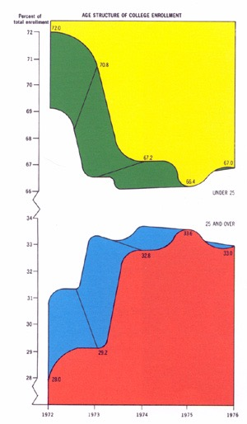

Slide 8
1

Slide 9
2

Slide 10
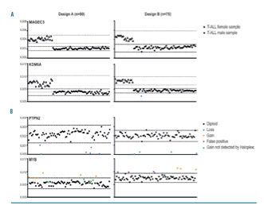
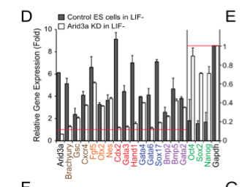
3

Slide 11
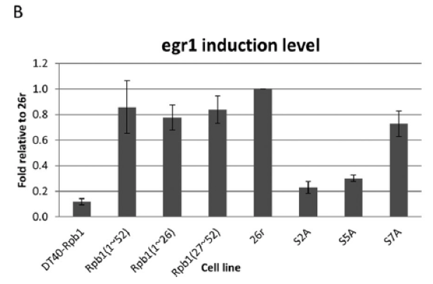
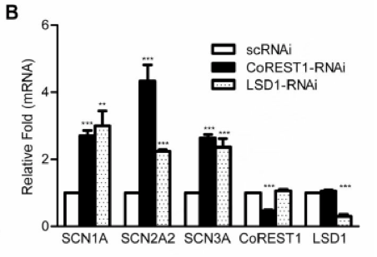
4

Slide 12
5

Slide 13
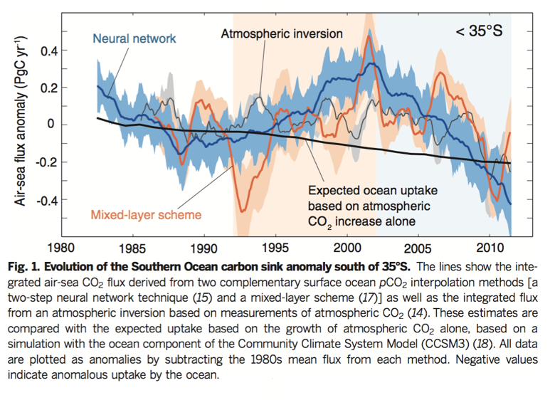
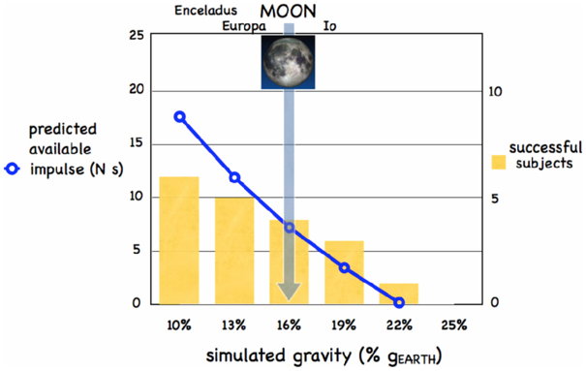
6

Slide 14
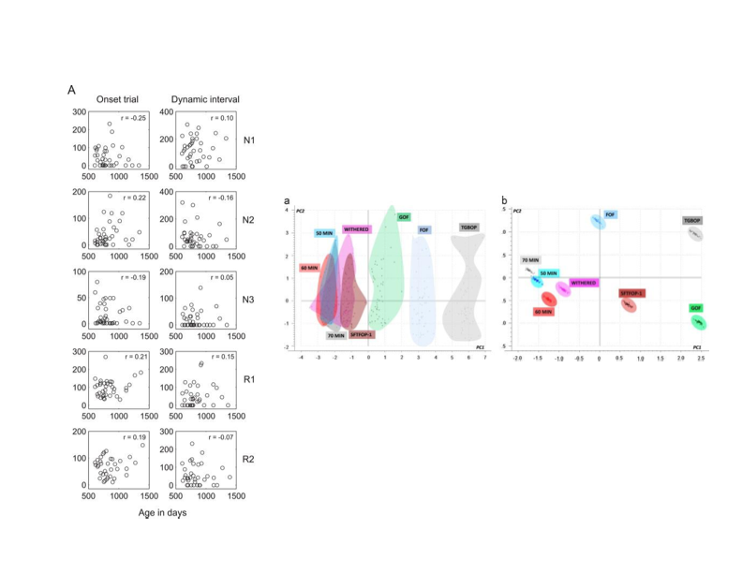
7

Slide 15
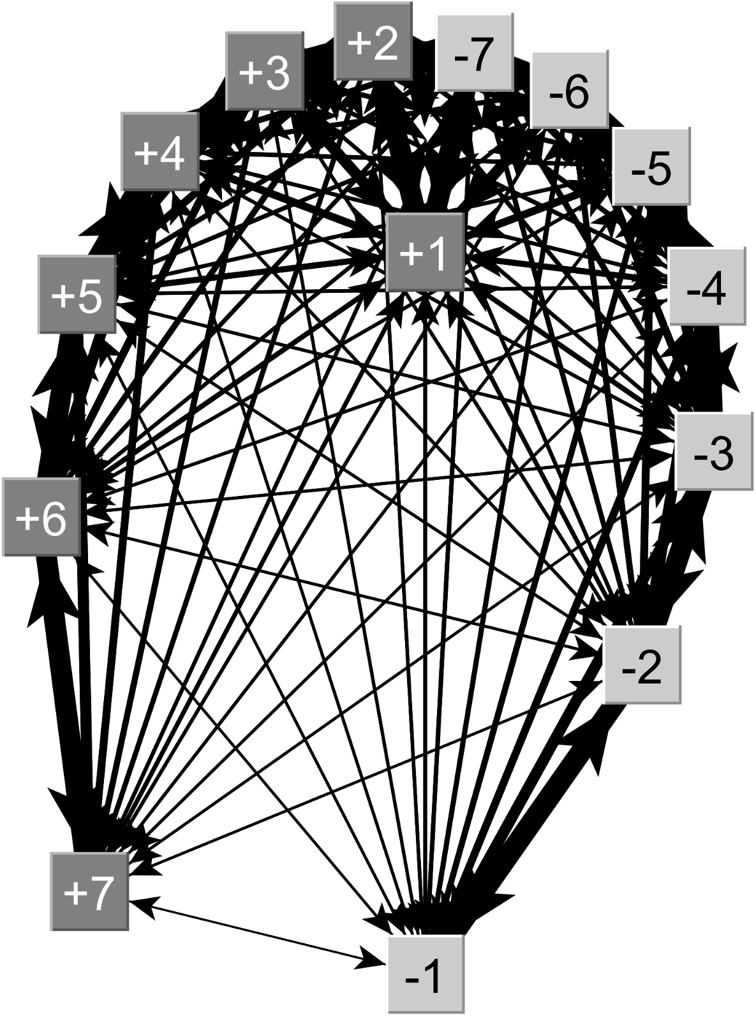
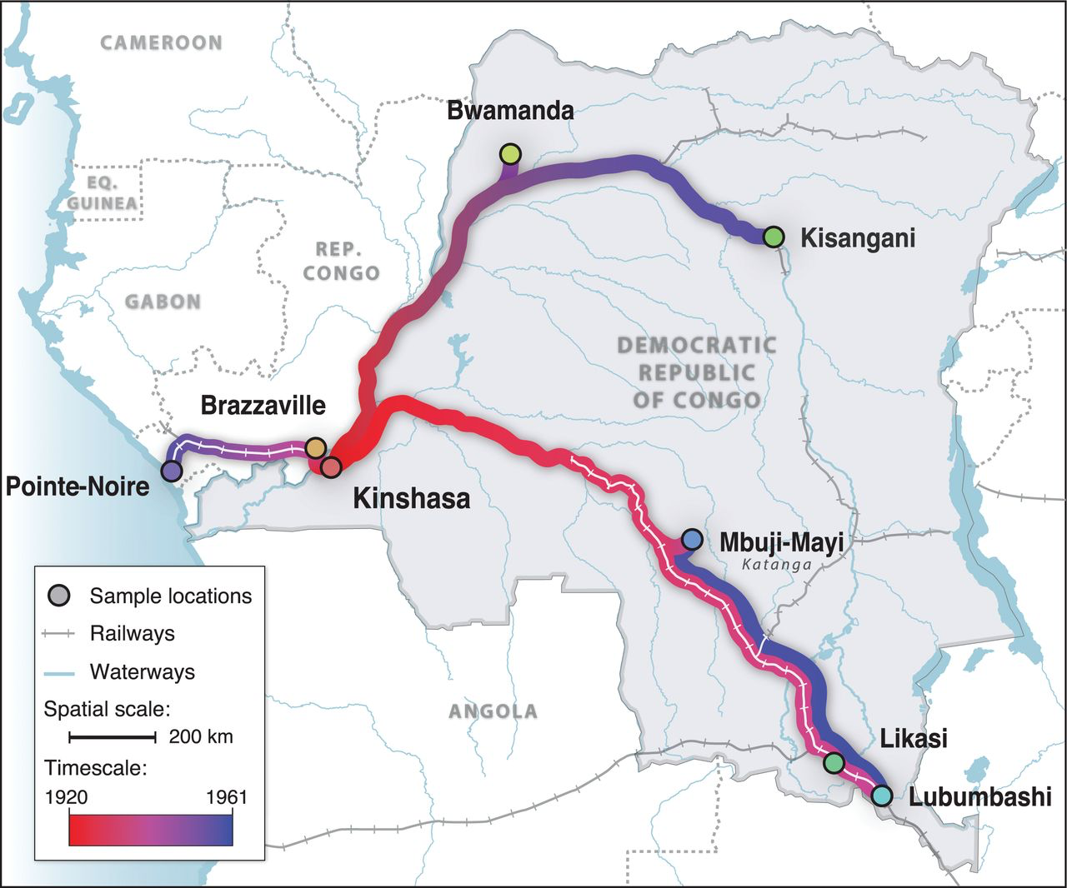
8

Slide 16
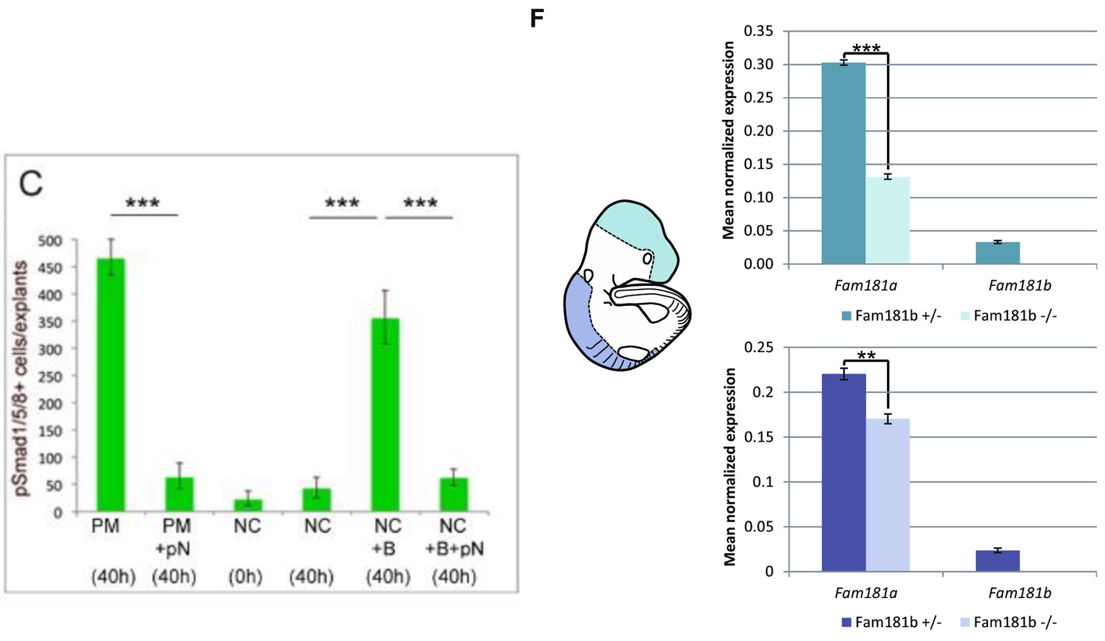
9

Slide 17
10

Slide 18
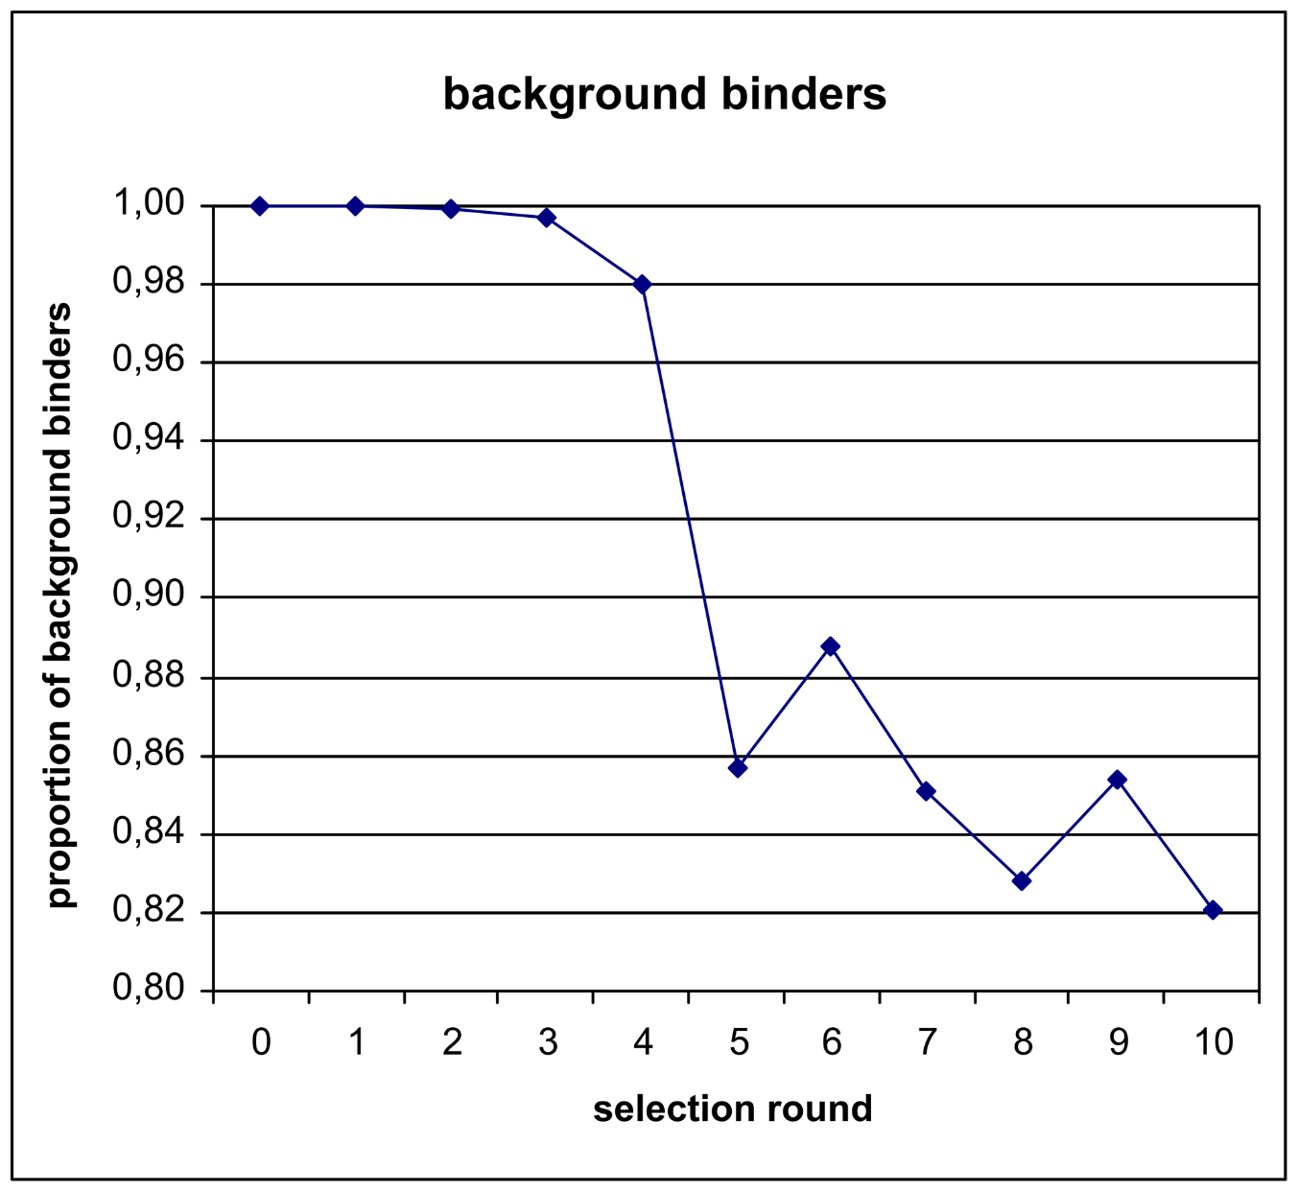
11

Slide 19
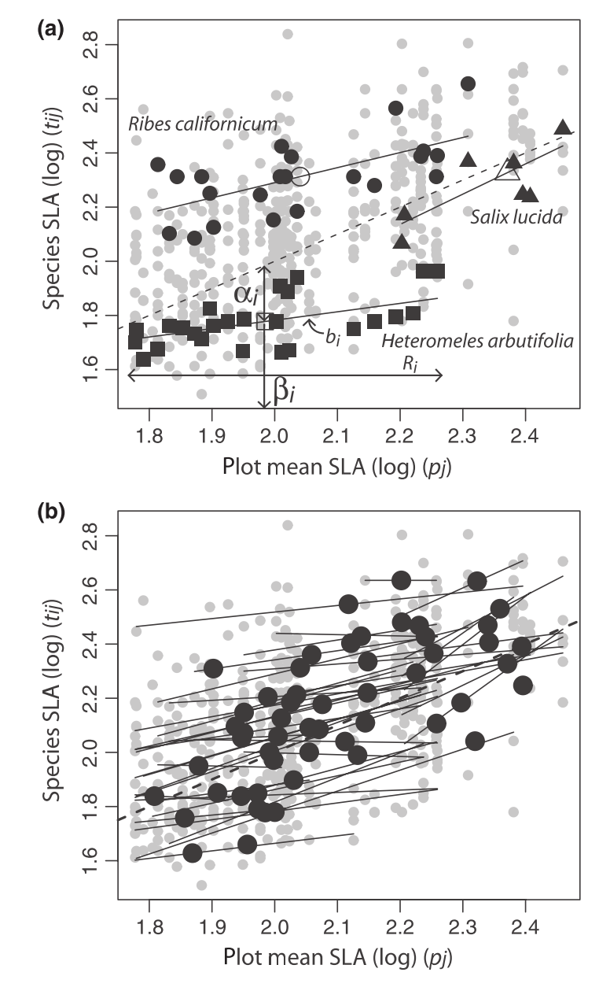
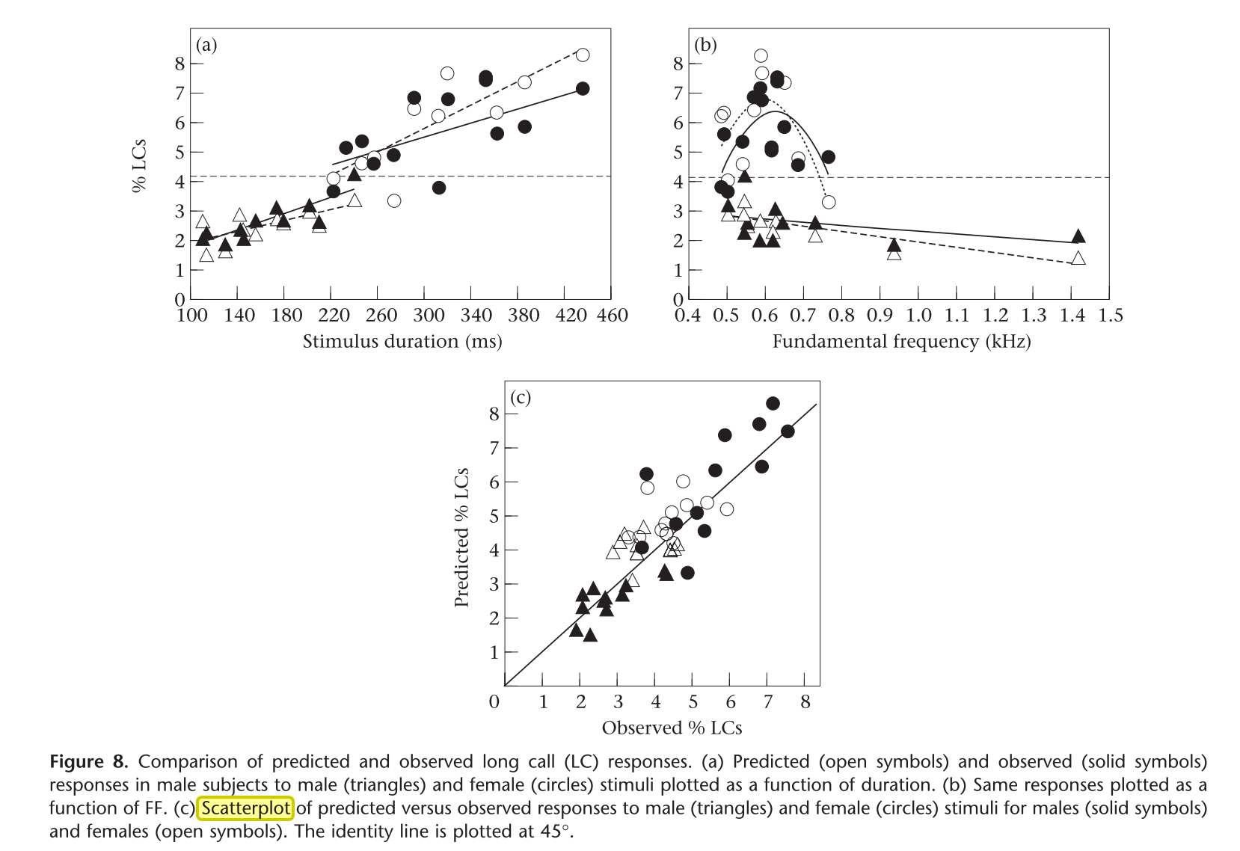
12

Slide 20
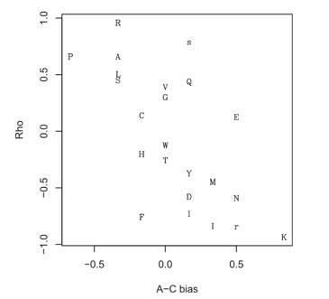
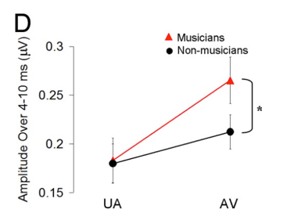
13

Slide 21
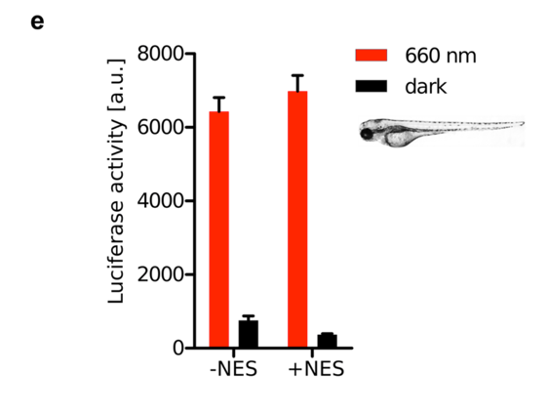
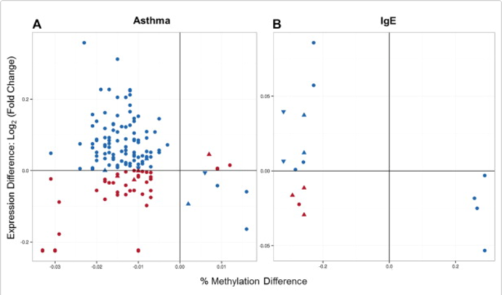
14

Slide 22
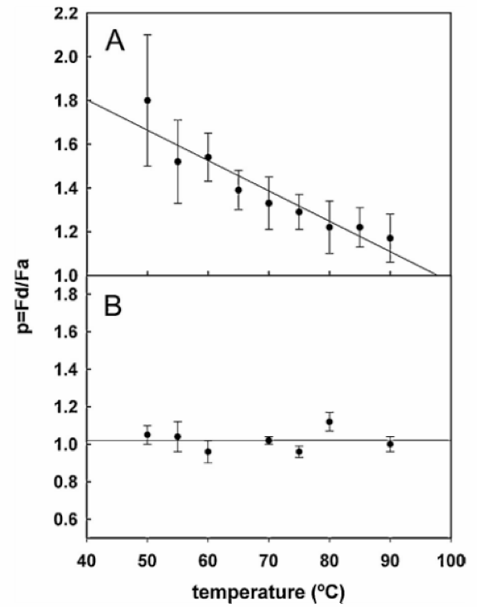
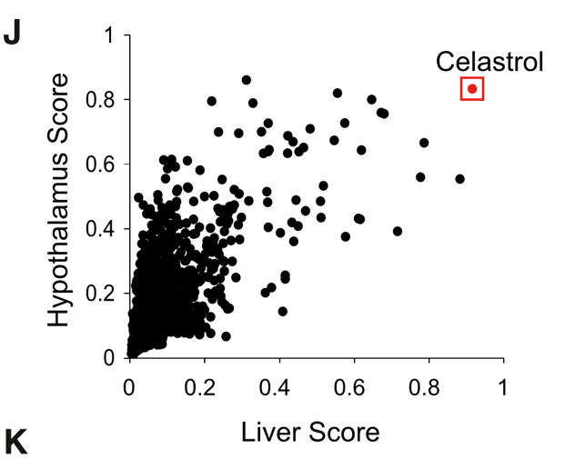
15

Slide 23
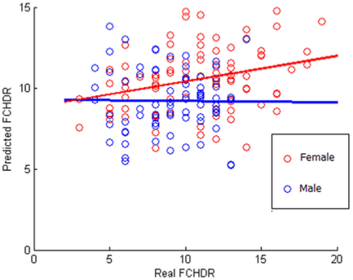
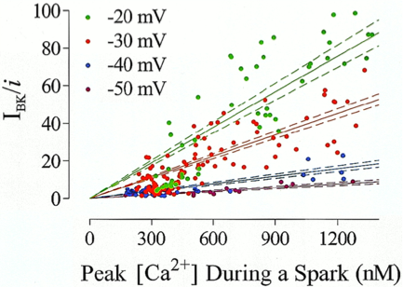
16

Slide 24
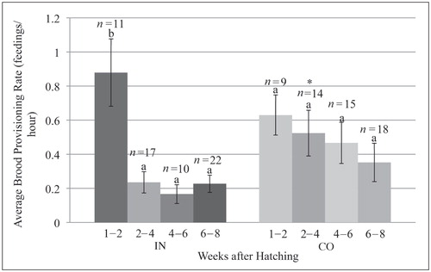
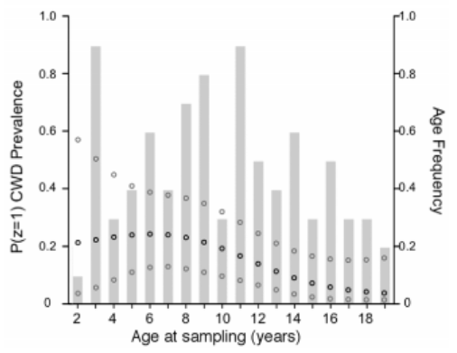
17

